Slide 1
SBIRT: Another Vital Sign
Behavioral Health Screening in the Primary Health Care Settings

Slide 2
Quote
“A body must be treated as a whole and not as a series of parts.”
-Hippocrates

Slide 3
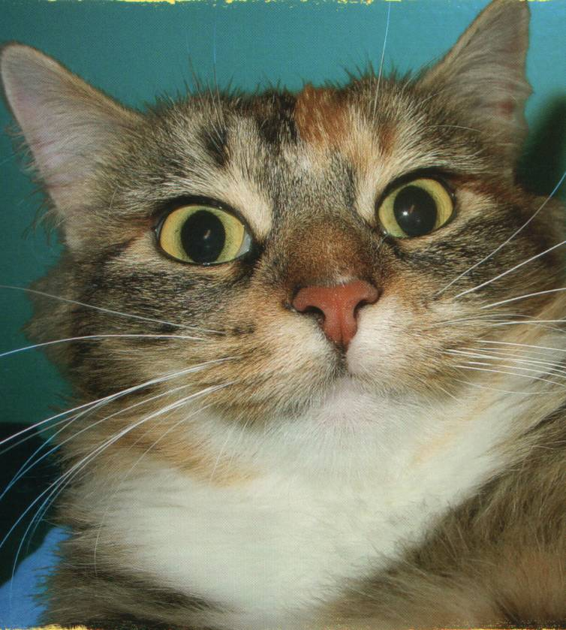
Cats & Dogs

Slide 4
Disclosures and Disclaimers

Slide 5
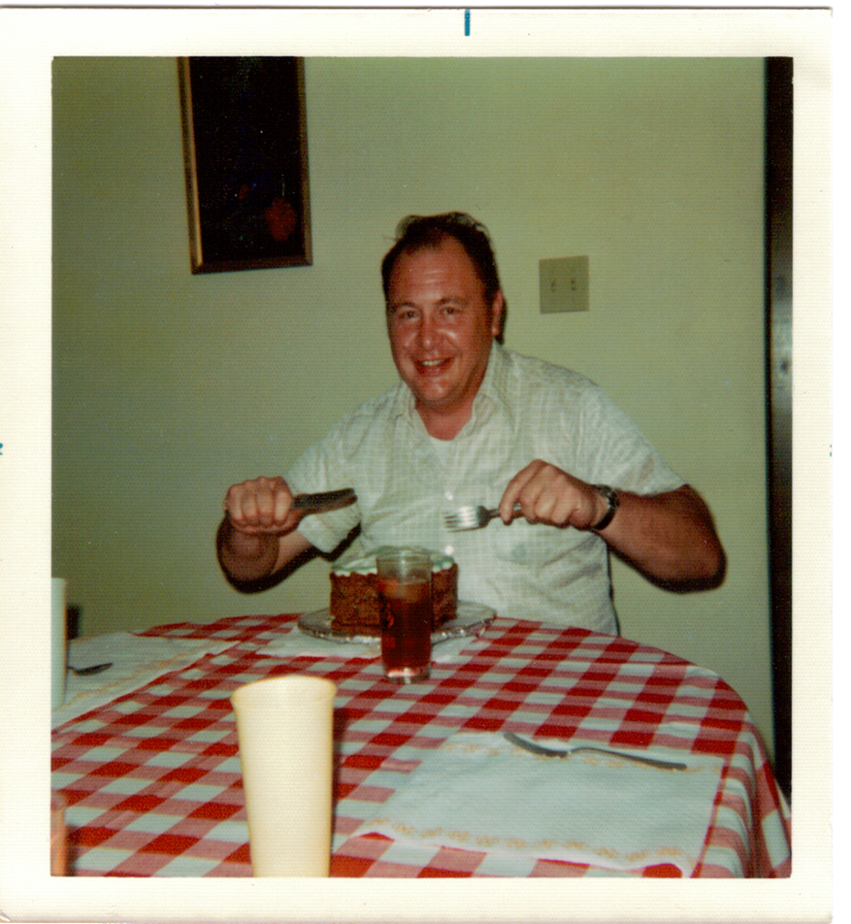

Slide 7
Do we have a PROBLEM with behavioral health issues?

Slide 8
Shooting rampage at Navy Yard in D.C. leaves 13 dead.

Slide 9
Woman Killed In D.C. Chase Was Delusional…

Slide 10
Man Sets Himself On Fire On The National Mall.

Slide 11
Drunk pilot caught just before take-off. Was 4.5 times the legal limit to fly.

Slide 12
Police Arrest Crea; City Judge Orders Mental Health Check.

Slide 13
Why aren’t we (as medical professionals) doing a better job fixing them? Do we really understand the problem?

Slide 14
Quote
“You have to understand the problem before you can find the solution.”
John N. Cernica, Ph.D., PE
Professor Emeritus, YSU

Slide 15
What are some of the Problems:
1. Identification
2. Treatment & Referral
3. Capacity

Slide 16
Identification

Slide 17
Can medical patients also have behavioral health problems?

Slide 18
Can behavioral health patients also have medical problems?

Slide 19
Overlap of behavioral and physical needs:

Slide 20
ONE Health Diagnostic Rates for Behavioral Health in 2011 and 2012
*From ONE Health Ohio annual UDS data.
**N=54,000 in 2012 and N=48,000 in 2011 (the entire population is the denominator)
***Also note: 2011 counted primary diagnosis only. In 2012 the UDS counted any level of diagnosis.

Slide 21
Should we routinely screen our medical patients for behavioral health problems?

Slide 22
Why should we ask our medical patients anything about their behavioral health status?

Slide 23
“Because that’s where the patients are.”
Notes:
Willie Sutton

Slide 24
ONE Health SBIRT
Added a depression component to the pre-screening and screening process.
We screen every patient with every medical visit.
Average medical visit/patient/year = three.

Slide 25
ONE Health SBIRT
Phase I: All Medical patients 18 and older.
Phase II: All Dental patients 18 and older.
Phase III: SBIRT through the Juvenile Justice Courts
Phase IV: Pediatric outpatients less than 18.

Slide 26
The SBIRT Process at the Youngstown Site

Slide 27
Pre-Screen
PHQ-9
DAST
AUDIT

Slide 28
Pre-screening
Questionnaire
Adapted and modified from SBIRT Oregon

Slide 29
Are patients willing to tell?

Slide 30
People Want to Tell
Total Kept Appointments | Total Screened | Total Refused
3125 | 2482 | 86
*During the SBIRT test period of February 17th through August 17th, 2013 at one site.

Slide 31
SBIRT Identification Rates

Slide 32
People Want To Tell
Question | YES | NO
Prior to seeing the doctor, you were asked questions about your alcohol/drug use and mood today. Were you upset by having to complete these questions? | 14 (9%) | 137 (91%)

Slide 33
People Want To Tell
Question | YES | NO
If questions about drug/ alcohol use and mood can help doctors improve care, would you recommend that others complete them? | 148 (99%) | 1 (1%)

Slide 34
“If you ask, they will tell.”
Ronald Dwinnells, M.D.

Slide 35
When They Tell, Do We Act?

Slide 36
Conclusions of the SBIRT Trial
Patients have no problems talking with providers about their behavioral health problems when asked.
Medical providers seem to have a problem talking to their patients about behavioral health issues (after the patient admits to having problems).
Medical providers are reluctant to “officially” diagnose behavioral health issues.

Slide 37
Why don’t patients tell unless asked?
Patients who go to medical doctors have been conditioned to think that doctors only take care of physical problems.

Slide 38
Why Don’t Providers Address This?
Providers are uncomfortable with the subject and not very well trained or up-to-date on these matters.
A busy medical provider does not have time for it. (15-20 minute patient visit appointments)
The reimbursement structure is poor for this service.

Slide 39
Goal for SBIRT
To improve our identification, intervention, treatment and referral rates of medical patients with behavioral health issues.

Slide 40
Diagnosis Rates

Slide 41
Time Study

Slide 42
Kept Referral Appointment Rates
Site\Condition | Depression | Alcohol | Drugs | Total
YCHC 2012 | 20.8% | 0 | 0 | 20%
*YCHC 2013 | 30.9% | 0 | 0 | 24%
WWCHC 2012 | 15.4% | 0 | 0 | 14.8%
WWCHC 2013 | 17.65% | 0 | 0 | 17.64%
* Six month test site.

Slide 43
Start Up Costs
Staff time for training: $ 731.01
Paper supplies: __35.00
Total Start up costs $766.01

Slide 44
Billable Service
http://www.osma.org/news/release.dT/effective-sept-1-ohio-medicaid-covers-sbirt-services/2236
(As of September 1, 2013)
The Medicaid Fee Schedule:
G0396 Alc/Sub Abuse test intervention 15-30 min- $25.05
G0397 Alc/Sub Abuse test intervention over 30 min- $47.68

Slide 45
Some Conclusions about SBIRT
Improved awareness of patient’s behavioral health status by medical providers and support staff.
Improved diagnostic rates.
Patients do not have a problem disclosing their behavioral health issues.
Time commitment is minimal.

Slide 46
Some Conclusions
There is minimal start-up costs.
People don’t go to referrals once they leave the office.
Medical providers are not too good with interventions.
SBIRT save lives!

Slide 47
WHERE do we go from here?
Integrative or collaborative Health Care Delivery system.
PCMH or Health Home development.
Encourage implementation of SBIRT at all medical practices.
Encourage legislative advocacy to support screening and integrative efforts.

Slide 50
Contact Information
Ronald Dwinnells, M.D.
726 Wick Avenue
Youngstown, Ohio 44505
330-747-2330
rdwinnells@onehealthohio.org

